Slide 1
Introduction to Supervised Machine Learning: Regression
MC. Luis Angel Galaviz Alejos
MS. Luis Angel Galaviz Alejos

Slide 2
Introduction

Slide 3




Artificial Intelligence

Slide 4














Data Science end to end
Get data
Build Model
Deploy Model

Slide 5
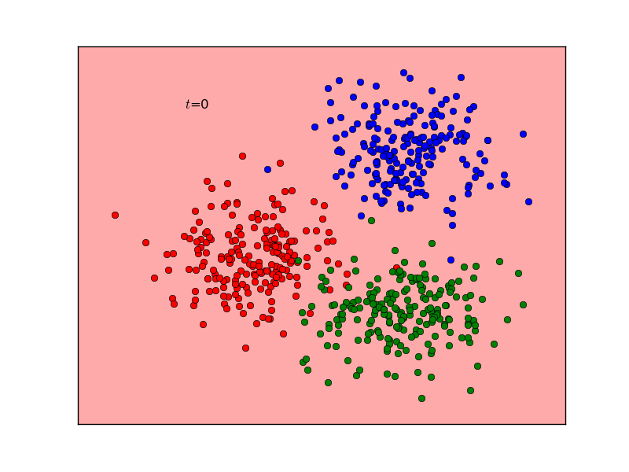
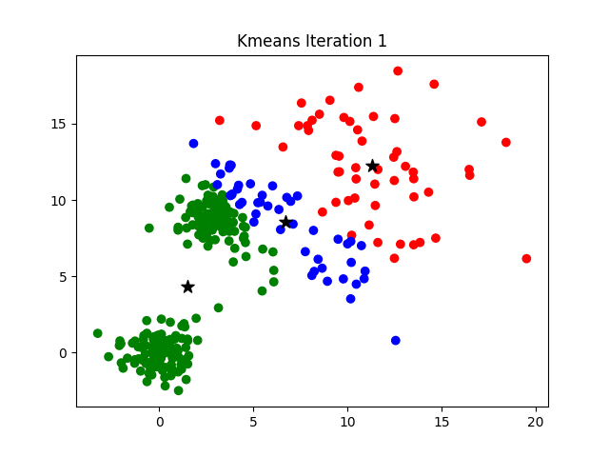
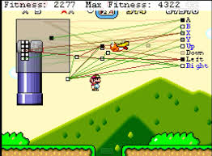
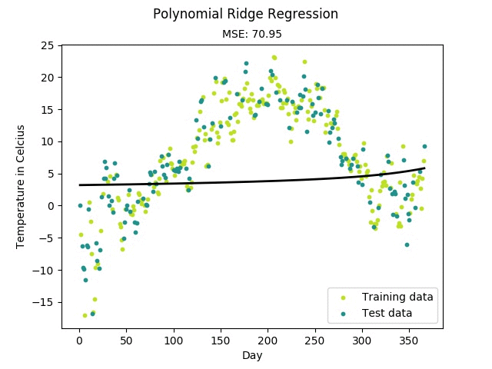
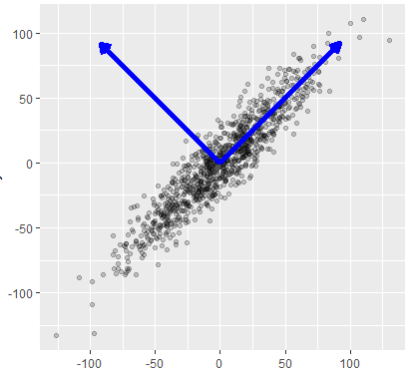
Machine Learning Types
Supervised
Unsupervised
Reinforced
Classification
Regression

Slide 6
Setup
1. Install Python Anaconda
2. Open Spyder by your OS file explorer

Slide 7
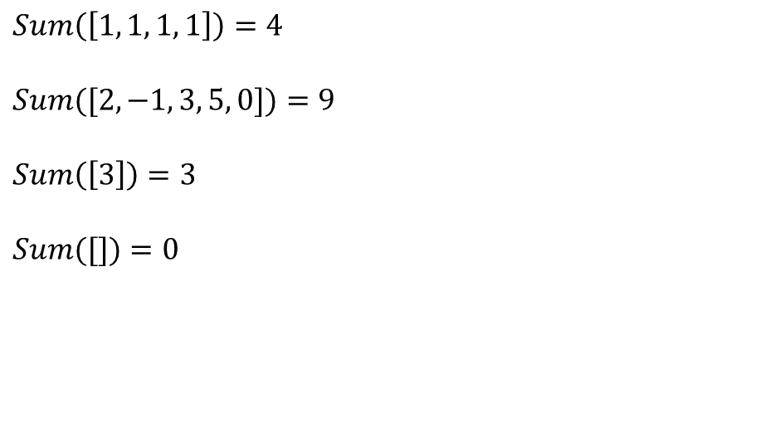
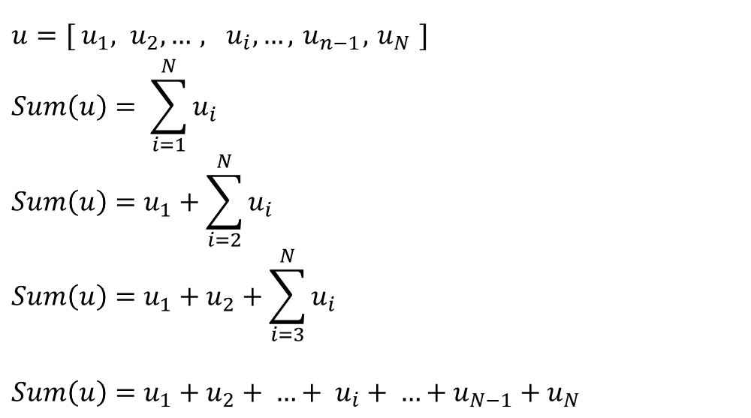
Coding Warmup – Problem #1
Problem #1 Sum of elements of an array
We have an vector/array u with N elements. Write a python program which finds the sum of all its elements.
$u={[ u}_{1}, u_{2}, …, u_{i}, …,{ u}_{n−1},{ u}_{N} ]$
$$Sum\left(u\right)= \sum_{i=1}^{N}{u_{i}}$$
$$Sum\left(u\right)=u_{1}+\sum_{i=2}^{N}{u_{i}}$$
$$Sum\left(u\right)=u_{1}+u_{2}+\sum_{i=3}^{N}{u_{i}}$$
$$Sum\left(u\right)=u_{1}+u_{2}+ …+ u_{i}+ …+u_{N−1}+u_{N}$$
$$Sum\left(\left[1, 1, 1, 1\right]\right)=4$$
$$Sum([2, −1, 3, 5, 0])=9$$
$$Sum\left(\left[3\right]\right)=3$$
$$Sum([])=0$$

Slide 8
Coding Warmup – Compare with numpy
N | Time Spent (ms)
 | Sum | Numpy Sum *
10,000 | 1.037 | 0.0
50,000 | 3.989 | 0.0
100,000 | 7.933 | 0.0
200,000 | 14.962 | 0.0
300,000 | 21.936 | 0.0
400,000 | 29.924 | 0.0
* Please be aware that the fact that numpy spent 0 ms means that python’s time package do not has enough resolution to be able to measure numpy’s sum elapsed time

Slide 9


Coding Warmup – Measuring Error
Problem #2 Measuring Error
We were doing an experiment on our electric engineering lab. According to our Ohm’s law calculations the voltage should be 100 volts. We assume that our calculated value is correct. We measured the voltage 10 times with two distinct voltmeters. Which voltmeter is better?
# | Red | Yellow
1 | 104 | 100
2 | 103 | 106
3 | 97 | 95
4 | 103 | 104
5 | 97 | 100
6 | 102 | 94
7 | 98 | 101
8 | 98 | 100
9 | 100 | 99
10 | 101 | 100

Slide 10
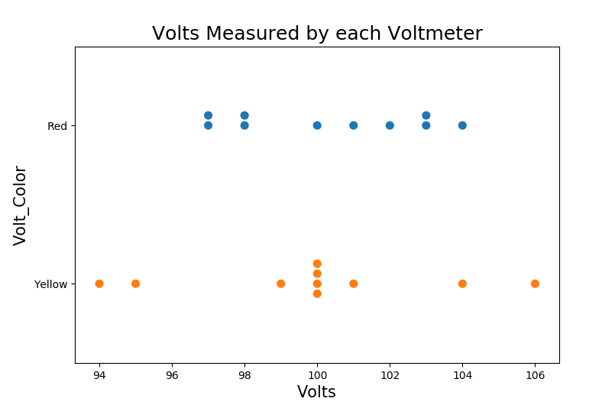
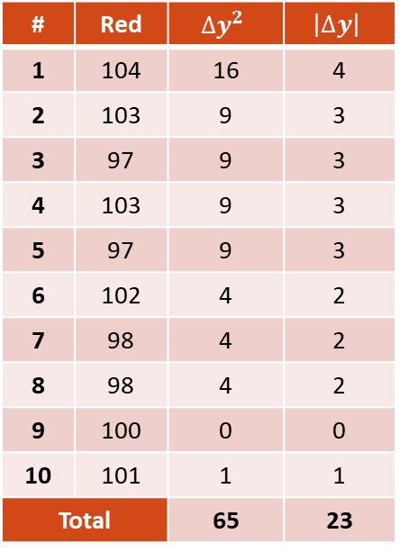
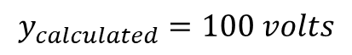
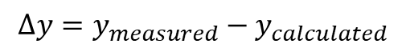
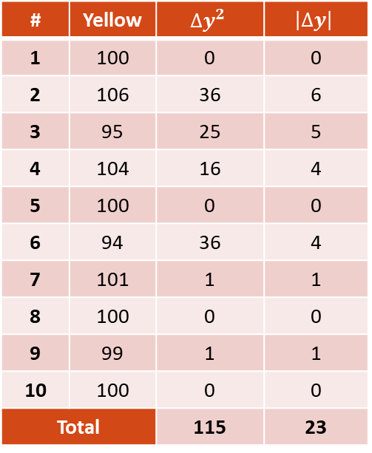
Coding Warmup – Measuring Error
$$∆y=y_{measured}−y_{calculated}$$
$$y_{calculated}=100 volts$$
# | Red | $${∆y}^{2}$$ | $$\left|∆y\right|$$
1 | 104 | 16 | 4
2 | 103 | 9 | 3
3 | 97 | 9 | 3
4 | 103 | 9 | 3
5 | 97 | 9 | 3
6 | 102 | 4 | 2
7 | 98 | 4 | 2
8 | 98 | 4 | 2
9 | 100 | 0 | 0
10 | 101 | 1 | 1
Total |  | 65 | 23
# | Yellow | $${∆y}^{2}$$ | $$\left|∆y\right|$$
1 | 100 | 0 | 0
2 | 106 | 36 | 6
3 | 95 | 25 | 5
4 | 104 | 16 | 4
5 | 100 | 0 | 0
6 | 94 | 36 | 4
7 | 101 | 1 | 1
8 | 100 | 0 | 0
9 | 99 | 1 | 1
10 | 100 | 0 | 0
Total |  | 115 | 23

Slide 11
Linear Regression

Slide 12
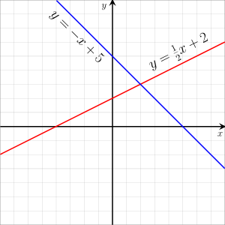
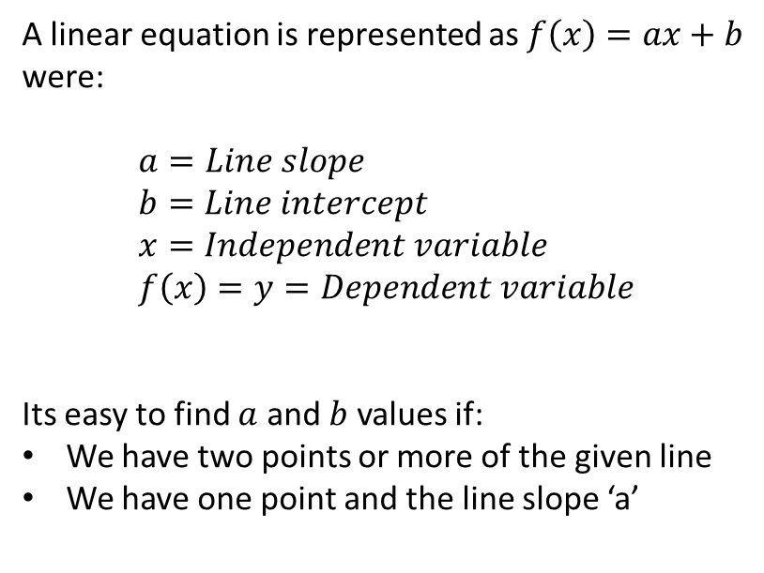
Linear Regression: The Line Equation
A linear equation is represented as $f\left(x\right)=ax+b$ were:
$$a=Line slope \\ b=Line intercept \\ x=Independent variable \\ f\left(x\right)=y=Dependent variable$$
Its easy to find $a$ and $b$ values if:
We have two points or more of the given line
We have one point and the line slope ‘a’
https://en.wikipedia.org/wiki/Linear_equation

Slide 13
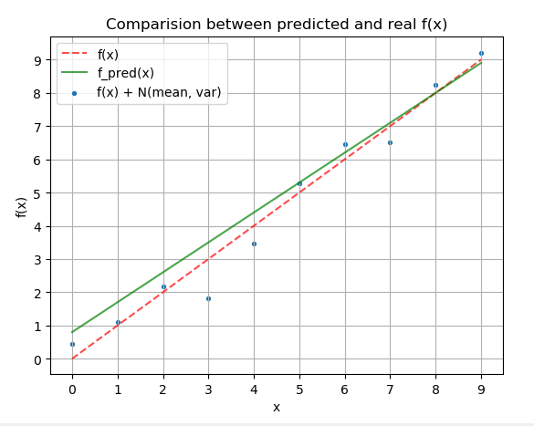
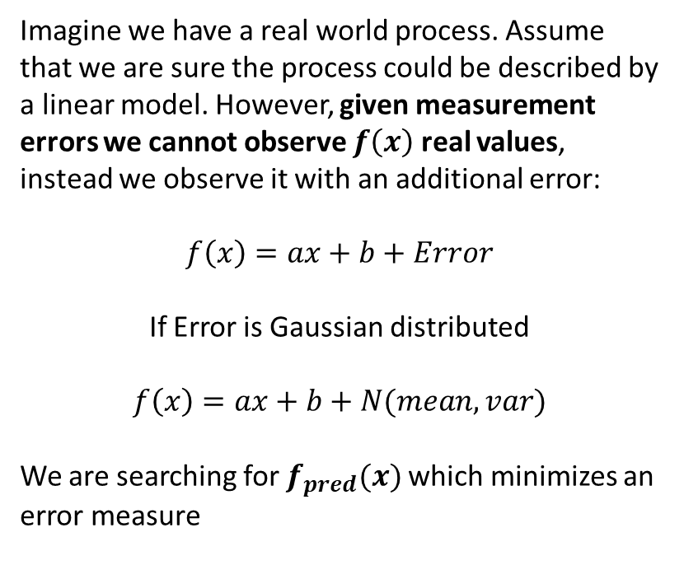
Linear Regression: A Noisy Line
Imagine we have a real world process. Assume that we are sure the process could be described by a linear model. However, given measurement errors we cannot observe $f\left(x\right)$ real values, instead we observe it with an additional error:
$f\left(x\right)=ax+b+Error$
If Error is Gaussian distributed
$$f\left(x\right)=ax+b+N(mean, var)$$
We are searching for $f_{pred}(x)$which minimizes an error measure

Slide 14
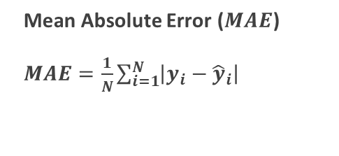
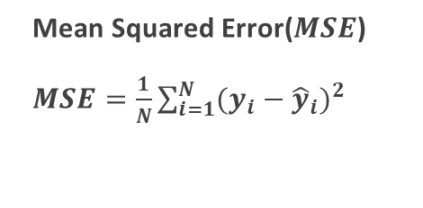
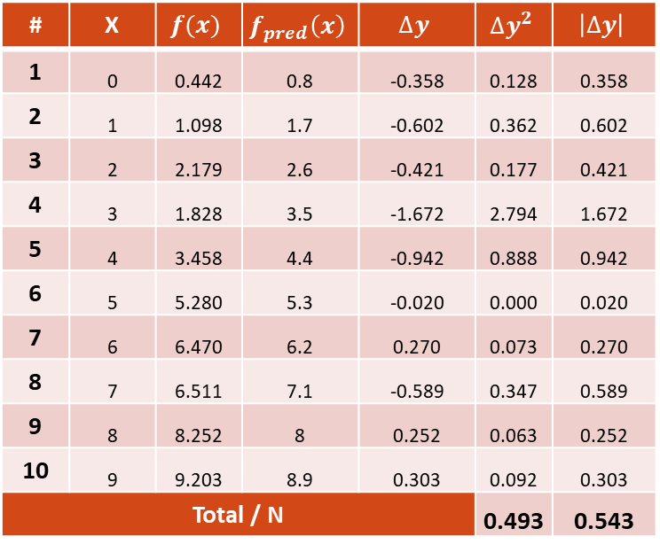
Linear Regression – Evaluating Error Functions
Mean Squared Error($MSE$)
$MSE=\frac{1}{N}\sum_{i=1}^{N}{{(y_{i}−{\hat{y}}_{i})}^{2}}$
Mean Absolute Error ($MAE$)
$MAE=\frac{1}{N}\sum_{i=1}^{N}{\left|y_{i}−{\hat{y}}_{i}\right|}$
# | X | $$f(x)$$ | $$f_{pred}\left(x\right)$$ | $$∆y$$ | $${∆y}^{2}$$ | $$\left|∆y\right|$$
1 | 0 | 0.442 | 0.8 | -0.358 | 0.128 | 0.358
2 | 1 | 1.098 | 1.7 | -0.602 | 0.362 | 0.602
3 | 2 | 2.179 | 2.6 | -0.421 | 0.177 | 0.421
4 | 3 | 1.828 | 3.5 | -1.672 | 2.794 | 1.672
5 | 4 | 3.458 | 4.4 | -0.942 | 0.888 | 0.942
6 | 5 | 5.280 | 5.3 | -0.020 | 0.000 | 0.020
7 | 6 | 6.470 | 6.2 | 0.270 | 0.073 | 0.270
8 | 7 | 6.511 | 7.1 | -0.589 | 0.347 | 0.589
9 | 8 | 8.252 | 8 | 0.252 | 0.063 | 0.252
10 | 9 | 9.203 | 8.9 | 0.303 | 0.092 | 0.303
Total / N |  |  |  |  | 0.493 | 0.543

Slide 15
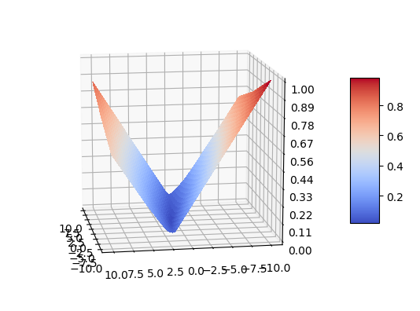
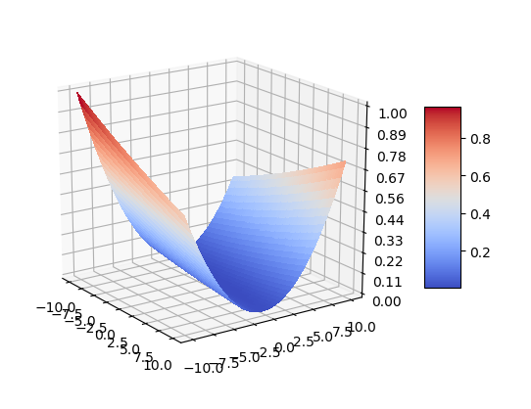
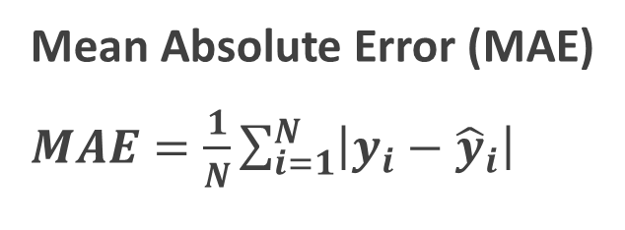
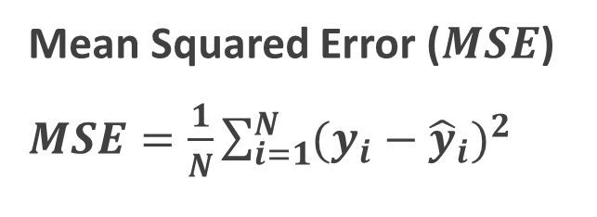
Linear Regression – Optimization Surfaces
Mean Squared Error ($MSE$)
$MSE=\frac{1}{N}\sum_{i=1}^{N}{{(y_{i}−{\hat{y}}_{i})}^{2}}$
Mean Absolute Error (MAE)
$MAE=\frac{1}{N}\sum_{i=1}^{N}{\left|y_{i}−{\hat{y}}_{i}\right|}$

Slide 16
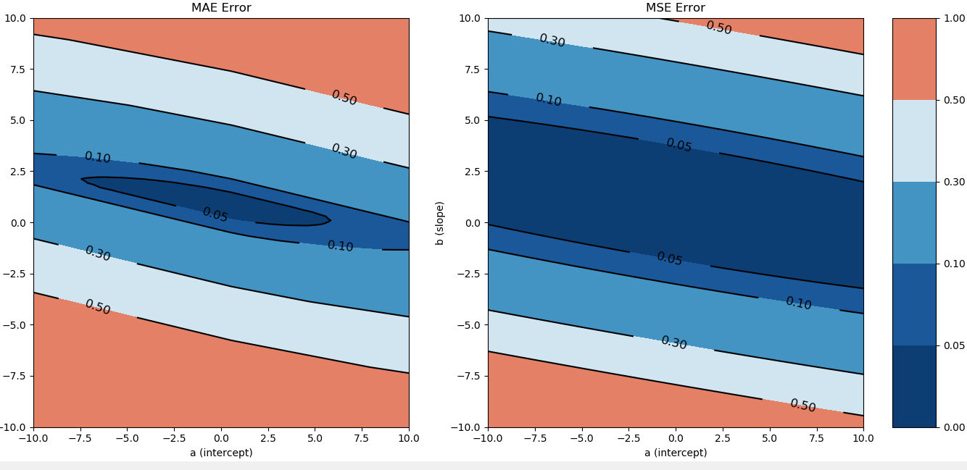
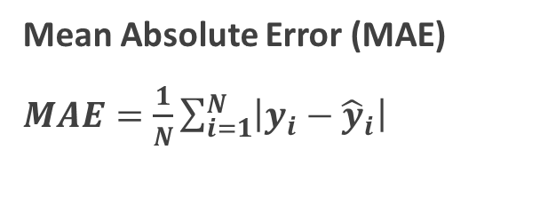
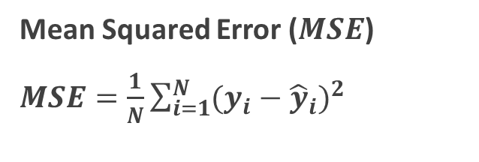
Linear Regression – Optimization Contours
Mean Absolute Error (MAE)
$MAE=\frac{1}{N}\sum_{i=1}^{N}{\left|y_{i}−{\hat{y}}_{i}\right|}$
Mean Squared Error ($MSE$)
$MSE=\frac{1}{N}\sum_{i=1}^{N}{{(y_{i}−{\hat{y}}_{i})}^{2}}$

Slide 17

Linear Regression: Graphical intuition
https://giphy.com/gifs/gradient-O9rcZVmRcEGqI/fullscreen

Slide 18
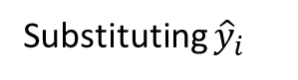
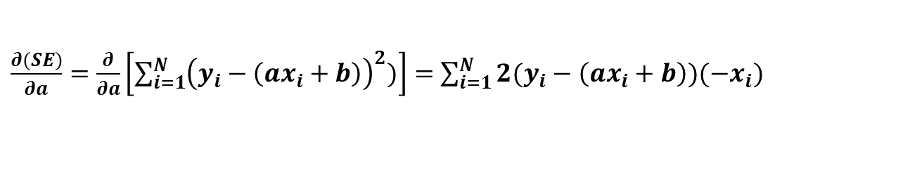
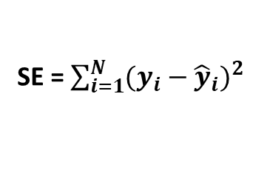
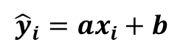
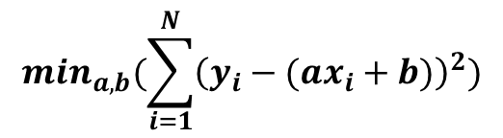
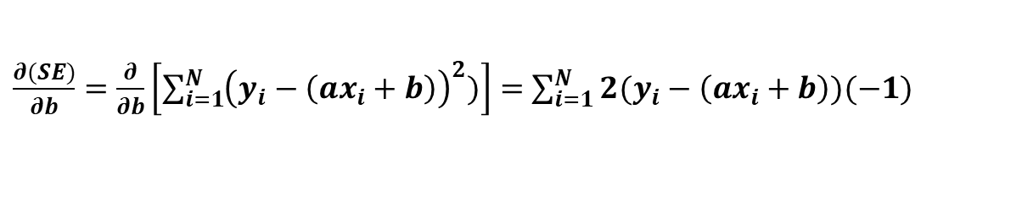
Linear Regression – Least Squares Regression
We should minimize Residuals Squared Error
SE = $\sum_{i=1}^{N}{{(y_{i}−{\hat{y}}_{i})}^{2}}$
Recall that
$${\hat{y}}_{i}=ax_{i}+b$$
Substituting ${\hat{y}}_{i}$
$$\min_{a,b}(\sum_{i=1}^{N}{{\left(y_{i}−(ax_{i}+b)\right)}^{2})}$$
We calculate MSE derivative. We have two variables $a$ and $b$, hence, two derivatives
$\frac{∂(SE)}{∂a}=\frac{∂}{∂a}\left[\sum_{i=1}^{N}{{\left(y_{i}−\left(ax_{i}+b\right)\right)}^{2})}\right]=$ $\sum_{i=1}^{N}{2(y_{i}−\left(ax_{i}+b\right))({−x}_{i})}$
$\frac{∂(SE)}{∂b}=\frac{∂}{∂b}\left[\sum_{i=1}^{N}{{\left(y_{i}−\left(ax_{i}+b\right)\right)}^{2})}\right]=$ $\sum_{i=1}^{N}{2(y_{i}−\left(ax_{i}+b\right))(−1)}$

Slide 19
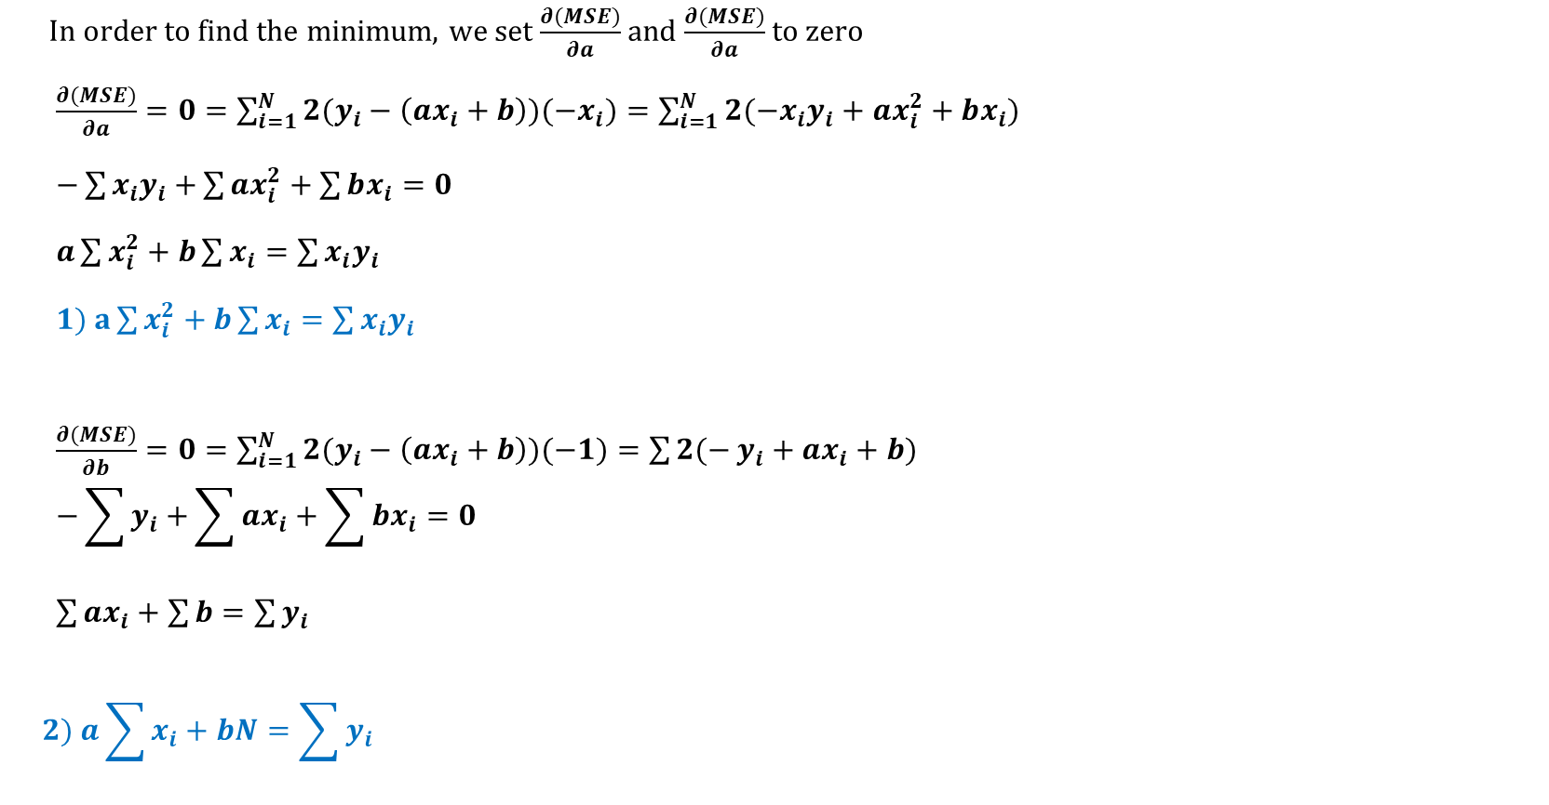
Linear Regression – LSR Derivatives
In order to find the minimum, we set $\frac{∂(MSE)}{∂a}$ and $\frac{∂(MSE)}{∂a}$ to zero
$\frac{∂(MSE)}{∂a}=0=\sum_{i=1}^{N}{2(y_{i}−\left(ax_{i}+b\right))({−x}_{i})}=\sum_{i=1}^{N}{2({{−x}_{i}y}_{i}+ax_{i}^{2}+bx_{i})}$
$−\sum{{x_{i}y}_{i}+}\sum{ax_{i}^{2}}+\sum{bx_{i}}=0$
$a\sum{x_{i}^{2}}+b\sum{x_{i}}=\sum{{x_{i}y}_{i}}$
$1) a\sum{x_{i}^{2}}+b\sum{x_{i}}=\sum{{x_{i}y}_{i}}$
$\frac{∂(MSE)}{∂b}=0=\sum_{i=1}^{N}{2(y_{i}−\left(ax_{i}+b\right))(−1)}=\sum{2(−}y_{i}+ax_{i}+b)$ $−\sum{y_{i}+}\sum{ax_{i}}+\sum{bx_{i}}=0$
$\sum{ax_{i}}+\sum{b}=\sum{y_{i}}$
$$2) a\sum{x_{i}}+bN=\sum{y_{i}}$$

Slide 20
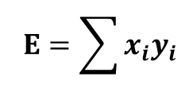
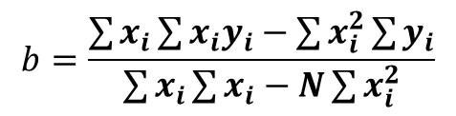
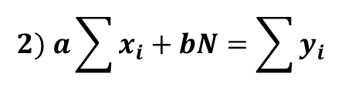
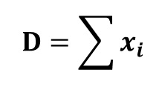
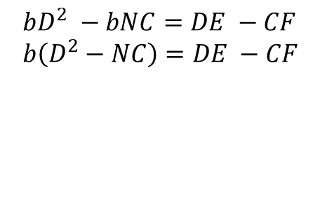
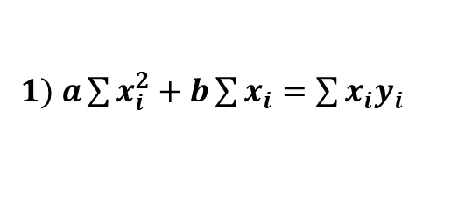
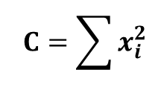
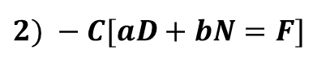
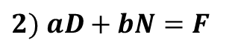
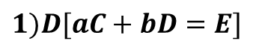
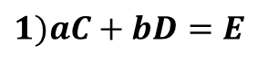
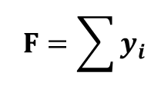
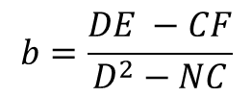
Linear Regression – LSR Solve
We solve Eq 1 and Eq 2 Simultaneously
$1) a\sum{x_{i}^{2}}+b\sum{x_{i}}=\sum{{x_{i}y}_{i}}$
$$C=\sum{x_{i}^{2}}$$
$$D=\sum{x_{i}}$$
$$E=\sum{{x_{i}y}_{i}}$$
$$F=\sum{y_{i}}$$
$$2) a\sum{x_{i}}+bN=\sum{y_{i}}$$
We multiply coefficient multiply both equations to resolve them
$$bD^{2} −bNC=DE −CF \\ b\left(D^{2}−NC\right)=DE −CF$$
$1)aC+bD=E$
$1)D[aC+bD=E]$
$$b=\frac{DE −CF}{D^{2}−NC}$$
$$2) aD+bN=F$$
$2) −C[aD+bN=F$]
$$b=\frac{\sum{x_{i}\sum{{x_{i}y}_{i}}}−\sum{x_{i}^{2}}\sum{y_{i}}}{\sum{x_{i}}\sum{x_{i}}−N\sum{x_{i}^{2}}}$$
By a similar method you can derive $a$ solution. Try it as an exercise!

Slide 21
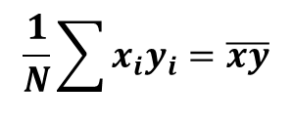
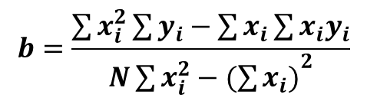
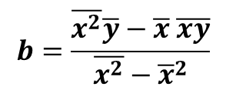
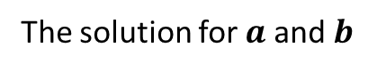






Linear Regression – LSR Solution
The solution for $a$ and $b$
$$a=\frac{N\sum{{x_{i}y}_{i}}−\sum{x_{i}\sum{y_{i}}}}{{N\sum{x_{i}^{2}}−(\sum{x_{i})}}^{2}}$$
$$b=\frac{\sum{x_{i}^{2}}\sum{y_{i}}−\sum{x_{i}\sum{{x_{i}y}_{i}}}}{{N\sum{x_{i}^{2}}−(\sum{x_{i})}}^{2}}$$
Recall that
$$\frac{1}{N}\sum{{x_{i}y}_{i}=\overline{xy}}$$
$$\frac{1}{N}\sum{x_{i}=\overline{x}}$$
$$\frac{1}{N}\sum{y_{i}=\overline{y}}$$
$$\frac{1}{N}\sum{x_{i}^{2}=\overline{x^{2}}}$$
We multiply both solutions by $\frac{1/{N^{2}}}{1/{N^{2}}}$
$$a=\frac{\overline{xy}−\overline{x} \overline{y}}{\overline{x^{2}}−{\overline{x}}^{2}}$$
$$b=\frac{\overline{x^{2}}\overline{y}−\overline{x} \overline{xy}}{\overline{x^{2}}−{\overline{x}}^{2}}$$

Slide 22


Linear Regression – Problem #1
Learning $f(x) =2x +1 + N(0, 2)$

Slide 23


Linear Regression – Problem #2
Learning $f(x) =Sin(x)+ N(0, 0.1)$

Slide 24
K Nearest Neighbors (KNN)

Slide 25

KNN – Graphical Intuition
https://www.youtube.com/watch?v=3lp5CmSwrHI

Slide 26
KNN – Graphical Intuition
https://www.youtube.com/watch?v=3lp5CmSwrHI

Slide 27

KNN – Simulated Data
https://www.youtube.com/watch?v=3lp5CmSwrHI

